Slide 1
Relationships between pixels

Slide 2
In this lecture, we consider several important relationships between pixels in a digital image.

Slide 3
Basic Relationships Between Pixels
Neighborhood
Adjacency
Connectivity
Paths
Regions and Boundaries

Slide 4
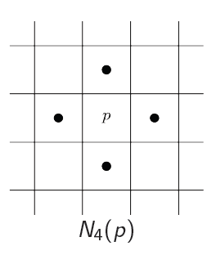
Neighbors of a Pixel
A pixel p at coordinates (x,y) has four horizontal and vertical neighbors whose coordinates are given by:
(x+1,y), (x-1, y), (x, y+1), (x,y-1)
This set of pixels, called the 4-neighbors or p, is denoted by N₄(p). Each pixel is one unit distance from (x,y) and some of the neighbors of p lie outside the digital image if (x,y) is on the border of the image.
 | (x, y-1)
(x-1, y) | P (x,y) | (x+1, y)
 | (x, y+1)

Slide 5
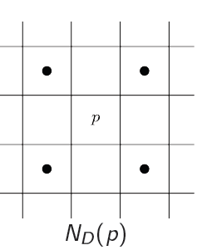
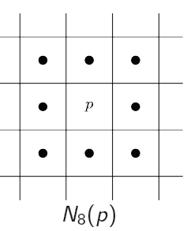
Neighbors of a Pixel
The four diagonal neighbors of p have coordinates:
(x+1, y+1), (x+1, y-1), (x-1, y+1), (x-1, y-1)
and are denoted by N_{D} (p).
These points, together with the 4-neighbors, are called the 8-neighbors of p, denoted by N₈ (p).
As before, some of the points in N_{D} (p) and N₈ (p) fall outside the image if (x,y) is on the border of the image.
(x-1, y+1) |  | (x+1, y-1)
 | P (x,y)
(x-1, y-1) |  | (x+1, y+1)
(x-1, y+1) | (x, y-1) | (x+1, y-1)
(x-1, y) | P (x,y) | (x+1, y)
(x-1, y-1) | (x, y+1) | (x+1, y+1)

Slide 6
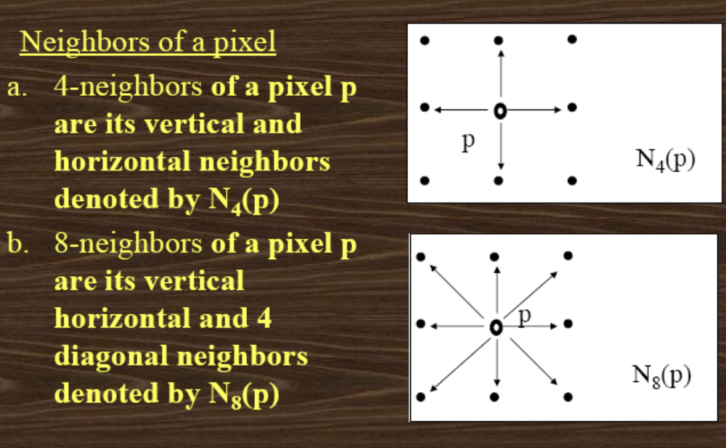

Neighbors of a Pixel

Slide 7
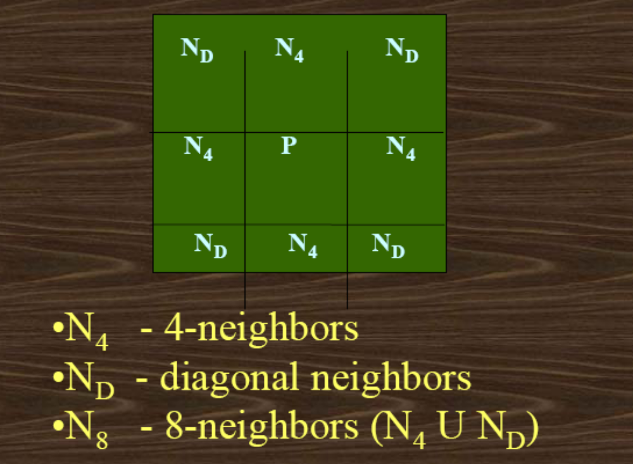
Neighbors of a Pixel

Slide 8
Adjacency and Connectivity

Slide 9
Adjacency
Two pixels are connected if they are neighbors and their gray levels satisfy some specified criterion of similarity.
For example, in a binary image two pixels are connected if they are 4-neighbors and have same value (0/1).

Slide 10
Adjacency
Let V: a set of intensity values used to define adjacency.
In a binary image, V = {1}, if we are referring to adjacency of pixels with value 1.
In a gray-scale image, the idea is the same, but V typically contains more elements, for example, V = {180, 181, 182, …, 200}
If the possible intensity values 0 – 255, V set can be any subset of these 256 values.

Slide 11
Types of Adjacency
4-adjacency: Two pixels p and q with values from V are 4-adjacent if q is in the set N₄(p).
8-adjacency: Two pixels p and q with values from V are 8-adjacent if q is in the set N₈(p).
m-adjacency =(mixed)

Slide 12
Types of Adjacency
m-adjacency:
Two pixels p and q with values from V are m-adjacent if :
    q is in N₄(p) or
    q is in N_{D}(p) and the set [N₄(p) ∩ N₄(q)] is empty i.e. has no pixel whose values are from V (no intersection)
Important Note: the type of adjacency used must be specified

Slide 13
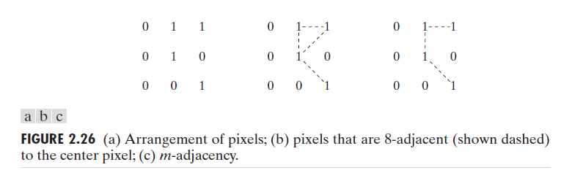
Types of Adjacency
Mixed adjacency is a modification of 8-adjacency. It is introduced to eliminate the ambiguities that often arise when 8-adjacency is used.
For example:

Slide 14
Types of Adjacency
In this example, we can note that to connect between two pixels (finding a path between two pixels):
  In 8-adjacency way, you can find multiple paths between two pixels
  While, in m-adjacency, you can find only one path between two pixels
So, m-adjacency has eliminated the multiple path connection that has been generated by the 8-adjacency.

Slide 15
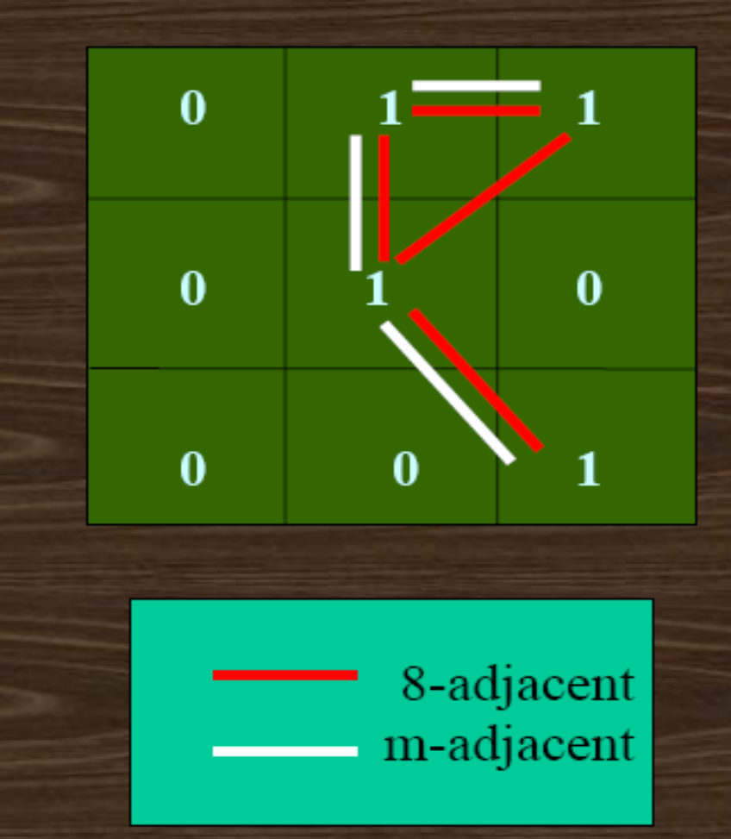
Adjacency/Connectivity

Slide 16
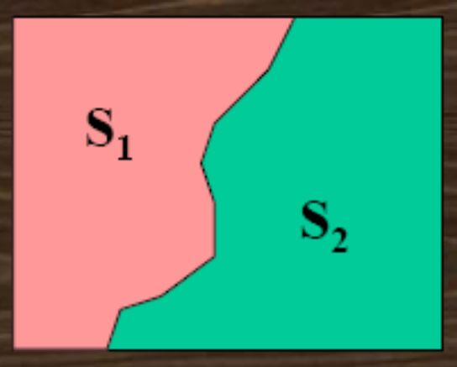
Adjacency/Connectivity
Pixel p is adjacent to pixel q if they are connected.
Two image subsets S1 and S2 are adjacent if some pixel in S1 is adjacent to some pixel in S2.

Slide 17
Paths & Path lengths
A path from pixel p with coordinates (x, y) to pixel q with coordinates (s, t) is a sequence of distinct pixels with coordinates:
(x0, y0), (x1, y1), (x2, y2) … (xn, yn),
where (x0, y0)=(x, y) and (xn, yn)=(s, t);
(xi, yi) is adjacent to (xi-1, yi-1) 1≤ i ≤ n
Here n is the length of the path.
We can define 4-, 8-, and m-paths based on type of adjacency used.

Slide 18
A Digital Path
Return to the previous example:
In figure (b) the paths between the top right and bottom right pixels are 8-paths. And the path between the same 2 pixels in figure (c) is m-path

Slide 19
Connectivity
If p and q are pixels of an image subset S then p is connected to q in S if there is a path from p to q consisting entirely of pixels in S.
For every pixel p in S, the set of pixels in S that are connected to p is called a connected component of S.
If S has only one connected component then S is called Connected Set.

Slide 20
Region and Boundary
A subset R of pixels in an image is called a Region of the image if R is a connected set.
The boundary of the region R is the set of pixels in the region that have one or more neighbors that are not in R.
If R happens to be entire Image?

Slide 21
Region and Boundary
If R happens to be an entire image, then its boundary is defined as the set of pixels in the first and last rows and columns in the image.
This extra definition is required because an image has no neighbors beyond its borders
Normally, when we refer to a region, we are referring to subset of an image, and any pixels in the boundary of the region that happen to coincide with the border of the image are included implicitly as part of the region boundary.

Slide 22
Distance Measures
For pixels p, q and z, with coordinates (x,y), (s,t) and (v,w), respectively, D is a distance function if:
(a) D (p,q) ≥ 0 (D (p,q) = 0 iff p = q),
(b) D (p,q) = D (q, p), and
(c) D (p,z) ≤ D (p,q) + D (q,z).

Slide 23
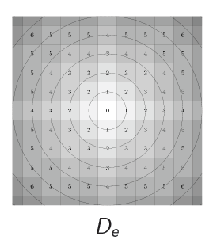
Distance Measures
The Euclidean Distance between p and q is defined as:
D_{e} (p,q) = [(x – s)² + (y - t)²]^{1/2}
Pixels having a distance less than or equal
to some value r from (x,y) are the points
contained in a disk of radius r centered at (x,y)
q (s,t)
D_{e} (p,q)
p (x,y)

Slide 24
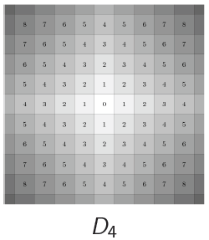
Distance Measures
The D₄ distance (also called city-block distance) between p and q is defined as:
D₄ (p,q) = | x – s | + | y – t |
Pixels having a D₄ distance from
(x,y), less than or equal to some
value r form a Diamond
centered at (x,y)
q (s,t)
D₄
p (x,y)

Slide 25
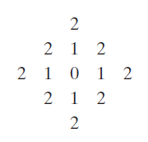
Distance Measures
Example:
The pixels with distance D₄ ≤ 2 from (x,y) form the following contours of constant distance.
The pixels with D₄ = 1 are
the 4-neighbors of (x,y)

Slide 26
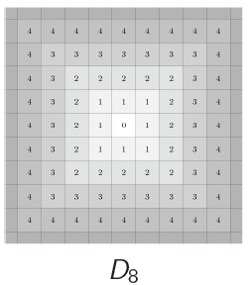
Distance Measures
The D₈ distance (also called chessboard distance) between p and q is defined as:
D₈ (p,q) = max(| x – s |,| y – t |)
Pixels having a D₈ distance from
(x,y), less than or equal to some
value r form a square
Centered at (x,y)
q (s,t)
D_{8(b)}
p (x,y)
D_{8(a)}
D₈ = max(D_{8(a) ,} D_{8(b)})

Slide 27
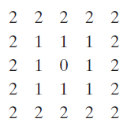
Distance Measures
Example:
D₈ distance ≤ 2 from (x,y) form the following contours of constant distance.

Slide 28
Distance Measures
Dm distance:
is defined as the shortest m-path between the points.
In this case, the distance between two pixels will depend on the values of the pixels along the path, as well as the values of their neighbors.

Slide 29

Distance Measures
Example:
Consider the following arrangement of pixels and assume that p, p₂, and p₄ have value 1 and that p₁ and p₃ can have can have a value of 0 or 1
Suppose that we consider
the adjacency of pixels
values 1 (i.e. V = {1})

Slide 30

Distance Measures
Cont. Example:
Now, to compute the D_{m} between points p and p₄
Here we have 4 cases:
Case1: If p₁ =0 and p₃ = 0
The length of the shortest m-path
(the D_{m} distance) is 2 (p, p₂, p₄)

Slide 31

Distance Measures
Cont. Example:
Case2: If p₁ =1 and p₃ = 0
the length of the shortest
path will be 3 (p, p₁, p₂, p₄)

Slide 32

Distance Measures
Cont. Example:
Case3: If p₁ =0 and p₃ = 1
The same applies here, and the shortest –m-path will be 3 (p, p₂, p₃, p₄)

Slide 33

Distance Measures
Cont. Example:
Case4: If p₁ =1 and p₃ = 1
The length of the shortest m-path will be 4 (p, p₁ , p₂, p₃, p₄)

